Slide 1
About Me
Performance Tuning .Net Lambdas
Scott Baldwin
Professional Software Engineer since 1997
Managing Consultant – Telstra Purple
AWS Ambassador
Telstra Purple Ambassador
Notes:
So, a little bit about myself…
I’ve been hacking code since 1997… it goes quick when you say it fast.
Fun fact, when I first started my career, I kept saying “I give myself 5 years in this industry… then I’ve gotta get out”…
After 15 years, I eventually convinced myself that I had to stop saying that….
I’m an AWS AND a Telstra Purple Ambassador… hoping for an overseas posting next round… We live in hope…

Slide 2
Notes:
On the odd occasion when I have spare time, I love dancing Argentinian Tango. I’ve been doing for over 20 years now…
Even tried to start my own tango school… Tango Duende …
It was a financial failure, which speaks more to my business acumen than anything else…
Still, I ended up falling in love with one of my students…

Slide 3
Notes:
And…. Well, let’s just say…
We have a saying in our house… Never trust a tango teacher…
Words to live by…

Slide 4
Goal for my talk
Deep-dive into the challenges of .Net Lambda Cold Start
Convince you that these issues can be overcome
Show where .Net Core really shines
Discuss some other performance hacks
To prove to Arjen C# is the best language to code in???

Slide 5
Notes:
About 4 years ago, I was doing some git training with a client
They told me that they had re-trained their entire development team from being a C# .Net shop to a python shop because of the unacceptable cold-start times of .Net core 2.1
I was shocked, and couldn’t believe what I was hearing, but I had no evidence to counter their decision, but I knew in my heart of hearts that there was something not quite right here.
This started me on a journey to understand what the real challenge here was, and so, I did a bit of research, and found that

Slide 6
Source: https://filia-aleks.medium.com/aws-lambda-battle-2021-performance-comparison-for-all-languages-c1b441005fd1
Notes:
Yeah, .Net cold starts do kinda suck.
I mean, it’s better than java, but that’s not really saying much.
It’s 10X worse than python

Slide 7
Comparison with other languages
AWS Lambda Battle 2021: performance comparison for all languages (cold and warm start)
Aleksandr Filichkin
Caveat: comparison done with .Net core 3.1
Notes:
Just a quick note on this particular analysis, this is done by Aleksandr Filichkin, and in contrast to other Cold Start analyses that look at a minimal but ultimately useless lambda implementation, this tries to introduce a small level of reality by writing to DynamoDB. This means the need to include SDK libraries.

Slide 8
Cold Start
Download
your code
Start new
container
Bootstrap
the runtime
Execute
your code
Cold Start
Warm Start
AWS
You

Slide 9
.Net Core Cold Start
Download
your code
Start new
container
Bootstrap
the runtime
JIT Compilation
Execute
your code
Cold Start
Warm Start
AWS
You

Slide 10
It Gets Worse…
JIT Compilation is per method
Lukewarm Start

Slide 11
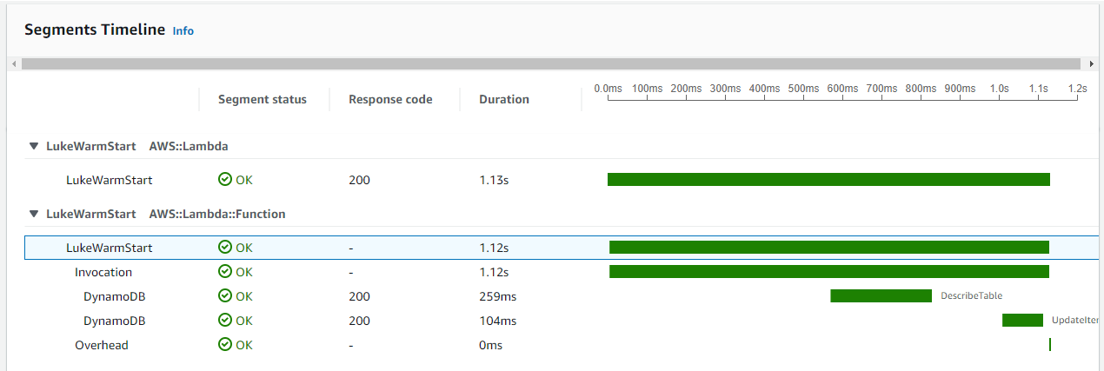
Cold Start: 4766ms
Lukewarm Start: 1120ms
P95: 116ms

Slide 12
Quick recap on goals…
Deep-dive into the challenges of .Net Lambda Cold Start
Convince you that these issues can be overcome

Slide 13
What am I missing?
JIT Compilation done on Background thread
Threads require CPU
256MB is the default in templates
In Lambda CPU ⬄ Memory
>CPU => faster JIT compilation => smaller Cold Start and Lukewarm start times

Slide 14
Invocation

Slide 15
Cold Start total

Slide 16
Lukewarm

Slide 17
Comparison with other languages
Source: https://filia-aleks.medium.com/aws-lambda-battle-2021-performance-comparison-for-all-languages-c1b441005fd1

Slide 18
Comparison with other languages
Source: https://filia-aleks.medium.com/aws-lambda-battle-2021-performance-comparison-for-all-languages-c1b441005fd1

Slide 19
ReadyToRun – Cold Start - Invocation

Slide 20
ReadyToRun - Lukewarm

Slide 21
Can do even better!!!
Lambda Native – Zac Charles
Claims Invocation improvements of up to 10X
Custom Lambda Runtime
ReadyToRun + Self-Contained deployment
Trimmed Self-Contained: .Net 6
So Why Not do this all the time?

Slide 22
JIT is .Net’s Superpower
Source: https://filia-aleks.medium.com/aws-lambda-battle-2021-performance-comparison-for-all-languages-c1b441005fd1

Slide 23
Orders of Magnitude Better for Warm Start
Source: https://filia-aleks.medium.com/aws-lambda-battle-2021-performance-comparison-for-all-languages-c1b441005fd1
Especially for CPU Bound tasks
16X faster than python

Slide 24
.Net 6 Performance Improvements
~550 PRs related to performance
Many of them to do with tiered compilation
Better GC
Improvements in System Types
Improvements in FileStream (especially on Linux)
Improvements in Networking
Many, Many more
JSONSerializer Source Generation

Slide 25
Advice
Know your workload + Non-Functional Requirements
rarely used API for SPA => ReadyToRun and/or large memory (2048MB+)
CPU Bound => JIT compile + large Memory (2048MB+)
IO Bound => smaller memory
Use threads if you can
95% of ALL performance issues are due to bad programming

Slide 26
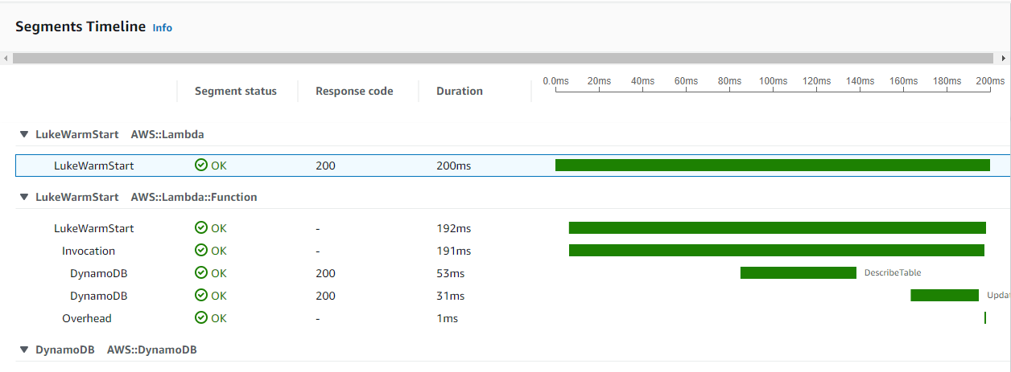
Other Considerations
SDK Choices, e.g DynamoDB Object Persistence Model Vs Standard API
Memory ⬄ Network
Cold Start CPU burst

Slide 27
Final Goal Checkin
Deep-dive into the challenges of .Net Lambda Cold Start
Convince you that these issues can be overcome
Show where .Net Core really shines
Discuss some other performance hacks
To prove to Arjen C# is the best language to code in???

Slide 28
Further Reading
Performance Improvements in .Net 6 – Stephen Toub – MSFT
AWS Lambda Battle 2021 Performance Comparison – Aleksandr Filichkin
Making .Net AWS Lambda Functions Start 10X Faster using LambdaNative – Zac Charles
.Net Lambda Lukewarm Starts – Scott Baldwin
.Net Lambda - analysis of Ready to Run – Scott Baldwin

